Slide 1
به نام خدا

Slide 2
OUT LINE
گروهئ علوم پایه
Neuroanatomy
Ascending tracts
دکتر مهرداد نقی خانی
Dr Mehrdad Naghikhani PhD of Anatomy and BS of PT, Assistant Professor, Department of Basic Sciences, USWR

Slide 3
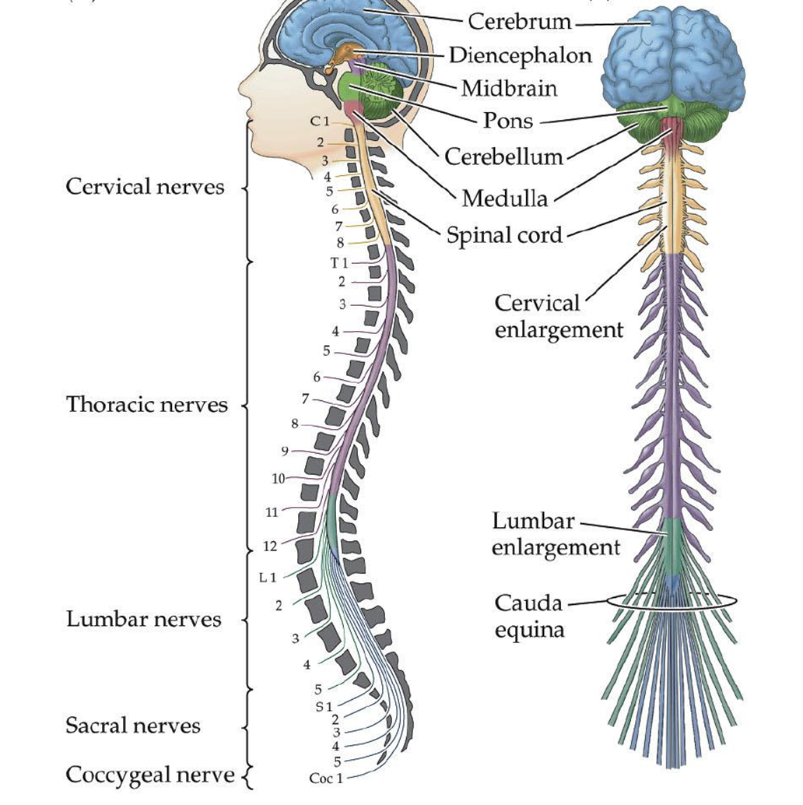
گروه علوم پایه
Vertebral canal
L1,Adulte
Child L2
Cervical and Lumbar enlargement
Conus medullaris
31 pairs spinal cord nerve
دکتر مهرداد نقی خانی
Dr Mehrdad Naghikhani PhD of Anatomy and BS of PT, Assistant Professor, Department of Basic Sciences, USWR

Slide 4
گروه علوم پایه
Arrangement of Nerve Fiber Tracts
The arrangement of the nerve fiber tracts within the spinal cord has been deduced as the result of animal experimentation and study of the human spinal cord for degenerative nerve fibers resulting from injury or disease. Although some nerve tracts are concentrated in certain areas of the white matter, it is now generally accepted that considerable overlap is present. For purposes of description, the spinal tracts are divided into ascending, descending, and intersegmental tracts, and their relative positions in the white matter are described below.
دکتر مهرداد نقی خانی
Dr Mehrdad Naghikhani PhD of Anatomy and BS of PT, Assistant Professor, Department of Basic Sciences, USWR

Slide 5
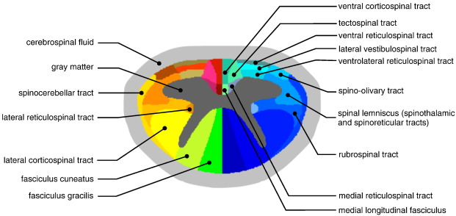
گروه علوم پایه
White matter
Ascending tracts
Descending tracts
Intersegmental tracts
دکتر مهرداد نقی خانی
Dr Mehrdad Naghikhani PhD of Anatomy and BS of PT, Assistant Professor, Department of Basic Sciences, USWR

Slide 6
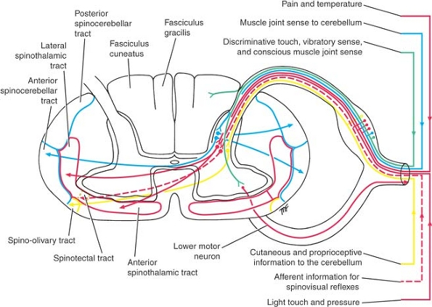
گروه علوم پایه
White matter
Ascending tracts
The ascending tracts conduct afferent information, which may or may not reach consciousness. The information may be divided into two main groups:
(1) Exteroceptive information, which originates from outside the body, such as pain, temperature, and touch.
(2) Proprioceptive information, which originates from inside the body, for example, from muscles and joints.
دکتر مهرداد نقی خانی
Dr Mehrdad Naghikhani PhD of Anatomy and BS of PT, Assistant Professor, Department of Basic Sciences, USWR

Slide 7
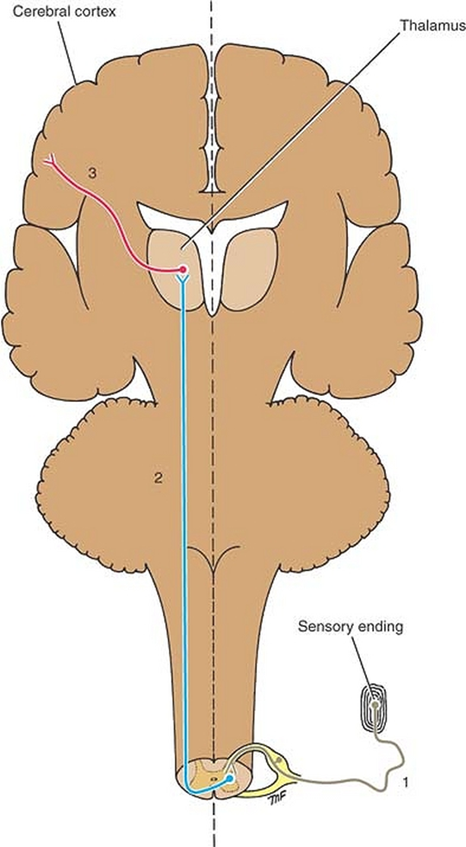
گروه علوم پایه
White matter
Ascending tracts
The first-order neuron, has its cell body in the posterior root ganglion of the spinal.
The second-order neuron gives rise to an axon that decussates (crosses to the opposite side)
The third-order neuron is usually in the thalamus and gives rise to a projection fiber that passes to a sensory region of the cerebral cortex.
دکتر مهرداد نقی خانی
Dr Mehrdad Naghikhani PhD of Anatomy and BS of PT, Assistant Professor, Department of Basic Sciences, USWR

Slide 8
گروه علوم پایه
Pain and Temperature Pathways
Lateral Spinothalamic Tract
The pain and thermal receptors in the skin and other tissues are free nerve endings
Fast-conducting delta A-type fibers and slow-conducting C-type fibers
دکتر مهرداد نقی خانی
Dr Mehrdad Naghikhani PhD of Anatomy and BS of PT, Assistant Professor, Department of Basic Sciences, USWR

Slide 9
گروه علوم پایه
Pain and Temperature Pathways
Lateral Spinothalamic Tract
The axons entering the spinal cord from the posterior root ganglion proceed to the tip of the posterior gray column(substantia gelatinosa) and divide into ascending and descending branches .
These branches travel for a distance of one or two segments of the spinal cord and form the posterolateral tract of Lissauer .
These fibers of the first-order neuron terminate by synapsing with cells in the posterior gray column, including cells in the substantia gelatinosa. Substance P, a peptide, is thought to be the neurotransmitter at these synapses
The axons of the second-order neurons now cross obliquely to the opposite side in the anterior gray and white commissures within one spinal segment of the cord, ascending in the contralateral white column as the lateral spinothalamic tract The lateral spinothalamic tract lies medial to the anterior spinocerebellar tract
دکتر مهرداد نقی خانی
Dr Mehrdad Naghikhani PhD of Anatomy and BS of PT, Assistant Professor, Department of Basic Sciences, USWR

Slide 10
گروه علوم پایه
Third-order neuron in the ventral posterolateral nucleus of the thalamus .
It is believed that here crude pain and temperature sensations are appreciated and emotional reactions are initiated.
دکتر مهرداد نقی خانی
Dr Mehrdad Naghikhani PhD of Anatomy and BS of PT, Assistant Professor, Department of Basic Sciences, USWR

Slide 11
گروه علوم پایه
Light (Crude) Touch and Pressure Pathways
Anterior Spinothalamic Tract
First order neuron
The axons enter the spinal cord from the posterior root ganglion and proceed to the tip of the posterior gray column, where they divide into ascending and descending branches.
Second order neuron in substantia gelatinosa group.
cross very obliquely to the opposite side in the anterior gray and white commissures within several spinal segments and ascend in the opposite anterolateral white column as the anterior spinothalamic.
Third order neuron in thalamus
In the medulla oblongata : the anterior spinothalamic tract, the lateral spinothalamic tract and the spinotectal tract, all of which form the spinal lemniscus
دکتر مهرداد نقی خانی
Dr Mehrdad Naghikhani PhD of Anatomy and BS of PT, Assistant Professor, Department of Basic Sciences, USWR

Slide 12
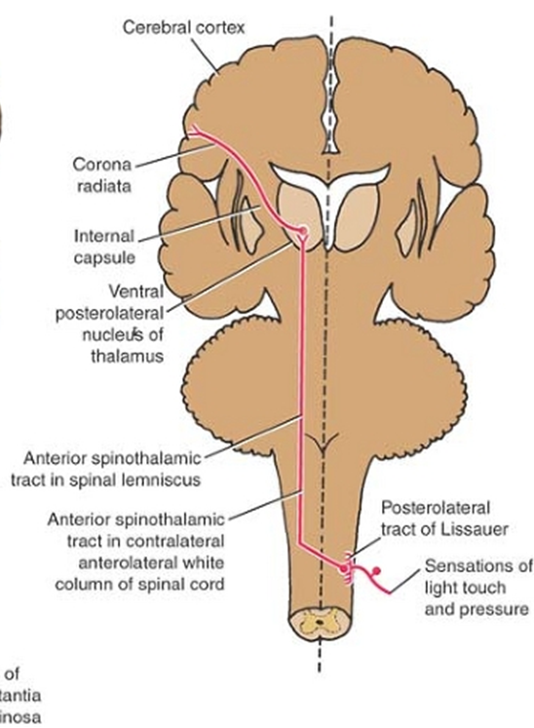
گروه علوم پایه
Light (Crude) Touch and Pressure Pathways
Anterior Spinothalamic Tract
In the medulla oblongata : the anterior spinothalamic tract, the lateral spinothalamic tract and the spinotectal tract, all of which form the spinal lemniscus
دکتر مهرداد نقی خانی
Dr Mehrdad Naghikhani PhD of Anatomy and BS of PT, Assistant Professor, Department of Basic Sciences, USWR

Slide 13
گروه علوم پایه
Discriminative Touch, Vibratory Sense, and Conscious Muscle Joint Sense
Posterior White Column: Fasciculus Gracilis and Fasciculus Cuneatus
Frist order neuron in dorsal gangelion
the fibers divide into long ascending and short descending branches. The descending branches pass down a variable number of segments, giving off collateral branches that synapse with cells in the posterior gray horn, with internuncial neurons, and with anterior horn cells.
It is clear that these short descending fibers are involved with intersegmental reflexes.
The long ascending fibers travel upward in the posterior white column as the fasciculus gracilis and fasciculus cuneatus.
Second order neuron in the nuclei gracilis and cuneatus of the medulla oblongata
Internal arcuate fiber , sensory decussation, internal lemniscus. Ventral posterolateral of thalamus
دکتر مهرداد نقی خانی
Dr Mehrdad Naghikhani PhD of Anatomy and BS of PT, Assistant Professor, Department of Basic Sciences, USWR

Slide 14
Discriminative Touch, Vibratory Sense, and Conscious Muscle Joint Sense
Posterior White Column: Fasciculus Gracilis and Fasciculus Cuneatus
گروه علوم پایه
دکتر مهرداد نقی خانی
Dr Mehrdad Naghikhani PhD of Anatomy and BS of PT, Assistant Professor, Department of Basic Sciences, USWR

Slide 15
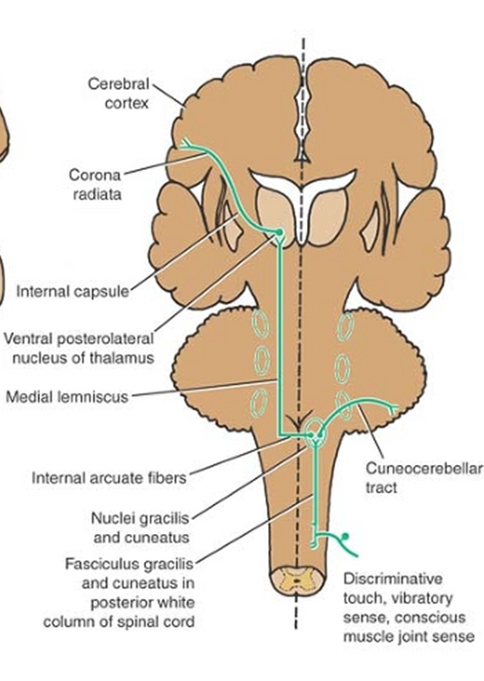
گروه علوم پایه
Muscle Joint Sense Pathways to the Cerebellum
Posterior Spinocerebellar Tract
Frist order neuron in dorsal root gangelion.
Second-order neurons at the base of the posterior gray column in nucleus dorsalis (Clarke's column).
Axon of second order neuron enter the posterolateral part of the lateral white column on the same side and ascend as the posterior spinocerebellar tract to the medulla oblongata. Here, the tract joins the inferior cerebellar peduncle and terminates in the cerebellar cortex.
Information trunk and lower limb
دکتر مهرداد نقی خانی
Dr Mehrdad Naghikhani PhD of Anatomy and BS of PT, Assistant Professor, Department of Basic Sciences, USWR

Slide 16
گروه علوم پایه
Muscle Joint Sense Pathways to the Cerebellum
Anterior Spinocerebellar Tract
First order neuron, The axons entering the spinal cord from the posterior root ganglion
The second-order neurons( clarks’ nucleus ) in the nucleus dorsalis at the base of the posterior gray column.
The fibers cross to the opposite side and ascend as the anterior spinocerebellar tract in the contralateral white column.
the superior cerebellar peduncle and terminate in the cerebellar cortex. It is believed that those fibers that crossed over to the opposite side in the spinal cord cross back within the cerebellum.
دکتر مهرداد نقی خانی
Dr Mehrdad Naghikhani PhD of Anatomy and BS of PT, Assistant Professor, Department of Basic Sciences, USWR

Slide 17
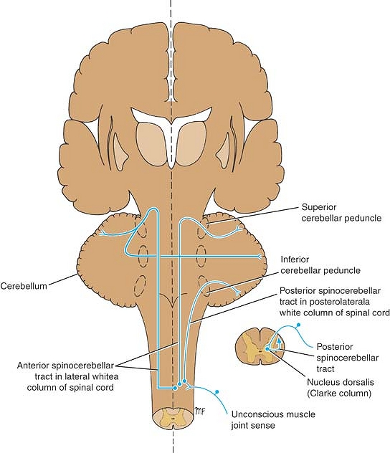
گروه علوم پایه
Muscle Joint Sense Pathways to the Cerebellum
Anterior Spinocerebellar Tract
دکتر مهرداد نقی خانی
Dr Mehrdad Naghikhani PhD of Anatomy and BS of PT, Assistant Professor, Department of Basic Sciences, USWR

Slide 18
گروه علوم پایه
Spinotectal Tract
The axons enter the spinal cord from the posterior root ganglion and travel to the gray matter where they synapse on unknown second-order neurons.
The axons of the second-order neurons cross the median plane and ascend as the spinotectal tract in the anterolateral white column lying close to the lateral spinothalamic tract. After passing through the medulla oblongata and pons, they terminate by synapsing with neurons in the superior colliculus of the midbrain.
This pathway provides afferent information for spinovisual reflexes and brings about movements of the eyes and head toward the source of the stimulation.
دکتر مهرداد نقی خانی
Dr Mehrdad Naghikhani PhD of Anatomy and BS of PT, Assistant Professor, Department of Basic Sciences, USWR

Slide 19
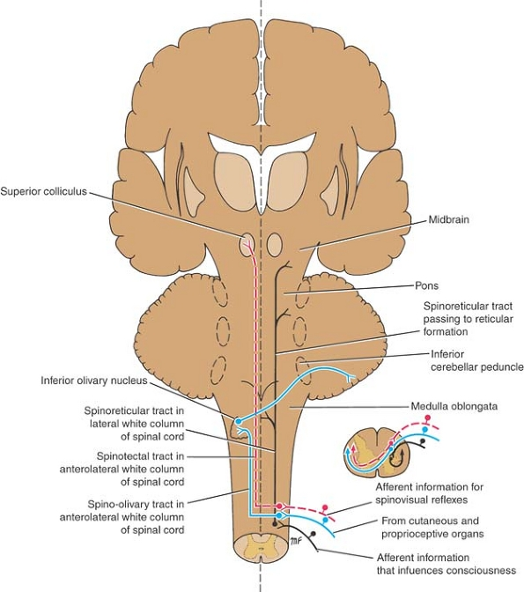
گروه علوم پایه
Spinotectal Tract
دکتر مهرداد نقی خانی
Dr Mehrdad Naghikhani PhD of Anatomy and BS of PT, Assistant Professor, Department of Basic Sciences, USWR

Slide 20
گروه علوم پایه
Spinoreticular Tract
The axons enter the spinal cord from the posterior root ganglion and terminate on unknown second-order neurons in the gray matter.
The axons from these second-order neurons ascend the spinal cord as the spinoreticular tract in the lateral white column mixed with the lateral spinothalamic tract. Most of the fibers are uncrossed and terminate by synapsing with neurons of the reticular formation in the medulla oblongata, pons, and midbrain.
The spinoreticular tract provides an afferent pathway for the reticular formation, which plays an important role in influencing levels of consciousness.
دکتر مهرداد نقی خانی
Dr Mehrdad Naghikhani PhD of Anatomy and BS of PT, Assistant Professor, Department of Basic Sciences, USWR

Slide 21
گروه علوم پایه
Spinoreticular Tract
The axons enter the spinal cord from the posterior root ganglion and terminate on unknown second-order neurons in the posterior gray column.
The axons from the second-order neurons cross the midline and ascend as the spino-olivary tract in the white matter at the junction of the anterior and lateral columns.
The axons end by synapsing on third-order neurons in the inferior olivary nuclei in the medulla oblongata.
The axons of the third-order neurons cross the midline and enter the cerebellum through the inferior cerebellar peduncle.
The spino-olivary tract conveys information to the cerebellum from cutaneous and proprioceptive organs
دکتر مهرداد نقی خانی
Dr Mehrdad Naghikhani PhD of Anatomy and BS of PT, Assistant Professor, Department of Basic Sciences, USWR

Slide 22
گروه علوم پایه
دکتر مهرداد نقی خانی
Dr Mehrdad Naghikhani PhD of Anatomy and BS of PT, Assistant Professor, Department of Basic Sciences, USWR

Slide 23
گروه علوم پایه
Visceral Sensory Tracts
Sensations that arise in viscera located in the thorax and abdomen enter the spinal cord through the posterior roots. The cell bodies of the first-order neuron are situated in the posterior root ganglia. The peripheral processes of these cells receive nerve impulses from pain4 and stretch receptor endings in the viscera. The central processes, having entered the spinal cord, synapse with second-order neurons in the gray matter, probably in the posterior or lateral gray columns.
The axons of the second-order neurons are believed to join the spinothalamic tracts and ascend and terminate on the third-order neurons in the ventral posterolateral nucleus of the thalamus. The final destination of the axons of the third-order neurons is probably in the postcentral gyrus of the cerebral cortex.
Many of the visceral afferent fibers that enter the spinal cord branch participate in reflex activity.
دکتر مهرداد نقی خانی
Dr Mehrdad Naghikhani PhD of Anatomy and BS of PT, Assistant Professor, Department of Basic Sciences, USWR

Slide 24
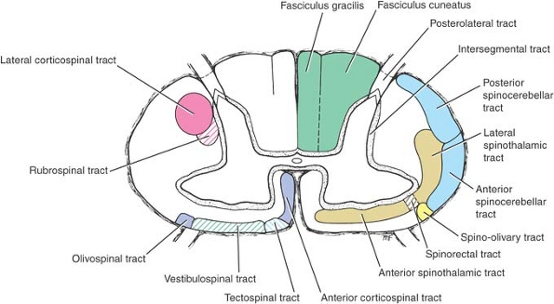
گروه علوم پایه
Ascending tracts
Tracts in the posterior white column
Fasciculus Gracilis and Cuneatus
Tracte in the anterior white column
Anterior spinothalamic tract
دکتر مهرداد نقی خانی
Dr Mehrdad Naghikhani PhD of Anatomy and BS of PT, Assistant Professor, Department of Basic Sciences, USWR

Slide 25
گروه علوم پایه
Ascending tracts in the lateral white column
Posterior spinocerebellar tract
Anterior spinocerebellar tract
Lateral spinothalamic tracts
Spino-tectal tract
Lissaure s’ tract
Spinoreticular tract
Spino-olivary tract
دکتر مهرداد نقی خانی
Dr Mehrdad Naghikhani PhD of Anatomy and BS of PT, Assistant Professor, Department of Basic Sciences, USWR

Slide 26
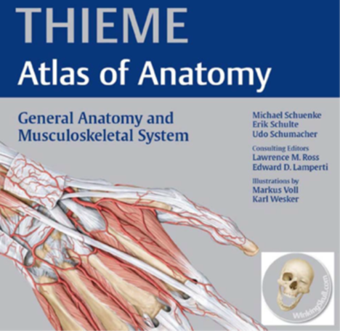
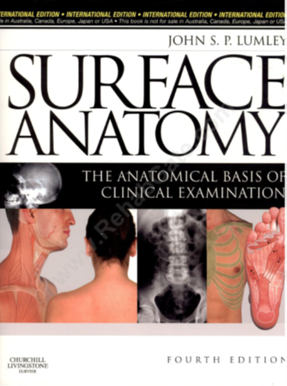
گروه علوم پایه
1-https://en.wikipedia.org
2- https://musculoskeletalkey.com
3
4
5
دکتر مهرداد نقی خانی
Dr Mehrdad Naghikhani PhD of Anatomy and BS of PT, Assistant Professor, Department of Basic Sciences, USWR

Slide 27
گروه علوم پایه
دکتر مهرداد نقی خانی

